Slide 1
جامعة ديالى / كلية الهندسة
قسم الهندسة الإلكترونية
8085 Microprocessor
Lecture 3
المدرس إياد قيس عبد الكريم
2018

Slide 2
Memory
جامعة ديالى / كلية الهندسة
قسم الهندسة الإلكترونية
Memory
What is memory? It is a circuit that can store bits high or low,
generally voltage levels or capacitive charges representing 1 and 0.
A Flip-flop or a latch is a basic element of memory
. To write or store a bit in the latch,
we need an input data bit D_{in} and an enable signal (EN).
2018

Slide 3
جامعة ديالى / كلية الهندسة
قسم الهندسة الإلكترونية
As shown in Figure. In this latch, the stored bit always available on the output of it to avoid unintentional change in the input and control the availability of the output, we can use two tri-state buffers on the latch, as shown in Figure . Now we can write into the latch by enabling the input buffer and read from it by enabling the output buffer. Figure shows the Write signal as WR and Read signal as RD; these are active low signals indicated by the bar. This latch, which can store one binary bit is called a memory cell.
.
2018

Slide 4
D_{in}
D
Q
Q_{out}
EN
EN
D_{in}
D
Q
Q_{out}
WR
EN
EN
RD

Slide 5
جامعة ديالى / كلية الهندسة
قسم الهندسة الإلكترونية
Figure (8-A) shows four such cells or latches grouped together, this is a register, which has four input lines and four output lines and can store four bits: thus the size of the memory word is four bits. The size of this register is specified either as 4-bit or 1 X 4-bit, which indicates one register with four cells or four I/O lines. Figures (8-B) and (8-C) show simplified block diagrams of the 4-bit register.
2018

Slide 6
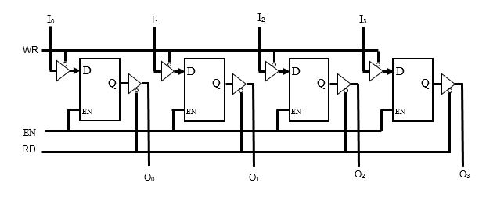

Slide 7
شكراً لإصغائكم ...
أسئلة ؟
2018

